Slide 1
CHAPTER : TWO
Intelligent Agent

Slide 2
Content
Intelligent Agent
Agent Schematic
Types of Agent
Rational Agents
Specifying Task Environments
Types of Environments

Slide 3
Intelligent Agent
I want to build a robot that will
  Clean my house
  Information filtering agents
  Cook when I don’t want to
  Wash my clothes
  Cut my hair
  Fix my car (or take it to be fixed)
  Take a note when I am in a meeting
  Handle my emails
  i.e. do the things that I don’t feel like doing…
AI is the science of building machines (agents) that act rationally with respect to a goal.

Slide 4
Types of Intelligent Agents
Software agents:
  Also called a softbot (software robot)
  It is an agent that interacts with a software environment by issuing commands and interpreting the environments feedback.
  E.g. mail handling agent, information filtering agent
Physical agents
  are robots that operates in the physical world and can perceive and manipulate objects in that world

Slide 5
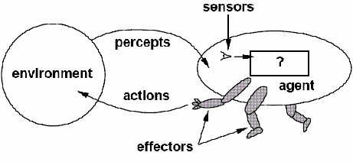
Agent
Agent is something that perceives/observes its environment through SENSORS and acts upon that environment through EFFECTORS.
The agent is assumed to exist in an environment in which it perceives and acts
An agent is rational/sensible since it does the right thing to achieve the specified goal.
Agent = architecture + program

Slide 6
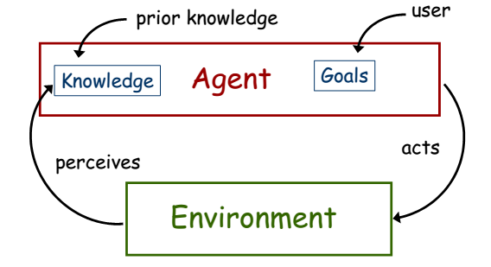
Require more flexible interaction with the environment, the ability to modify one’s goals, knowledge that be applied flexibly to different situations

Slide 7
Agent
 | Human beings | Agents
Sensors | Eyes, Ears, Nose | Cameras, Scanners, Mic, infrared range finders
Effectors | Hands, Legs, Mouth | Various Motors (artificial hand, artificial leg), Speakers, Radio

Slide 8
Examples of agents in different types of applications
Agent type
Percepts
Actions
Goals
Environment
Healthy patients, minimize costs
Medical diagnosis system
Symptoms, patient's answers
Questions, tests, treatments
Patient, hospital
Interactive English tutor
Typed words, questions, suggestions
Write exercises, suggestions, corrections
Maximize student's score on exams
Set of students, materials
Part-picking robot
Pixels of varying intensity
Pick up parts and sort into bins
Place parts in correct bins
Conveyor belts with parts
Print a categorization of scene
Correct categorization
Images from orbiting satellite
Satellite image analysis system
Pixels intensity, color
Refinery controller
Temperature, pressure readings
Open, close valves; adjust temperature
Maximize purity, yield, safety
Refinery

Slide 9
Rationality/Reasonableness vs. Omniscience/Awareness/knowledge
Rational agent acts so as to achieve one's goals, given one's beliefs (one that does the right thing).
  What does right thing mean? one that will cause the agent to be most successful and is expected to maximize goal achievement, given the available information
An Omniscient/all-knowing agent knows the actual outcome of its actions, and can act accordingly, but in reality omniscience is impossible.
Rational agents take action with expected success, where as omniscient agent take action with 100% sure of its success
Is human beings Omniscient or Rational agent?

Slide 10
Example
You are walking along the road to shewaber; You see an old friend across the street. There is no traffic.
So, being rational, you start to cross the street.
Mean while a big banner falls off from above and before you finish crossing the road, you are flattened.
Were you irrational to cross the street?
This points out that rationality is concerned with expected success, given what has been perceived.
  Crossing the street was rational, because most of the time, the crossing would be successful, and there was no way you could have foreseen the falling banner.
  The EXAMPLE shows that we can not blame an agent for failing to take into account something it could not perceive. Or for failing to take an action that it is incapable of taking.

Slide 11
Rational agent
In summary what is rational at any given point depends on four things.
  Perception/sensitivity: Everything that the agent has perceived so far concerning the current scenario in the environment
  Knowledge: What an agent already knows about the environment
  Action: The actions that the agent can perform back to the environment
  Performance measure: The performance measure that defines degrees of success of the agent.
Generally, rationality refers to “doing the right thing”.
  So that one key property of Intelligent Agents is being a rational agent, because rational agents means doing the right thing.
Therefore in designing an intelligent agent, one has to remember PEAS (Performance, Environment, Actuators, Sensors) framework.

Slide 12
Example 1: PEAS description for Automated Taxi Driver.
  Performance Measure
    How much it is safe, fast, legal, comfortable trip, maximize profits, etc.
  Environment
    The roads, pedestrians, customers, other traffic.
  Actuators
    The steering wheel, accelerator, brake, signal, horn, etc.
  Sensors
    The cameras, sonar, speedometer, GPS, odometer, engine sensors, keyboard, etc.

Slide 13
Example 2: PEAS description of Part-Sorting Robot
  Performance Measure
    Percentage of parts in correct bins
  Environment
    Conveyor belt with parts, bins
  Actuators
    Robotic arm
  Sensors
    Camera, joint angle sensors

Slide 14
Example 3: PEAS description of Spam Filter
  Performance Measure
    Minimizing false positives, false negatives
  Environment
    A user’s email account
  Actuators
    Mark as spam, delete, etc.
  Sensors
    Incoming messages, other information about user’s account

Slide 15
Performance measure
How do we decide whether an agent is successful or not?
  Establish a standard of what it means to be successful in an environment and use it to measure the performance.
  A rational agent should do whatever action is expected to maximize its performance measure, on the basis of the evidence provided by the percept sequence and whatever built-in knowledge the agent has.
What is the performance measure for “crossing the road”?
What about “Chess Playing”?

Slide 16
Assignment
Consider the need to design a “taxi driver agent” that serves in Debre markos city;
  Identify what to perceive, actions to take, the environment it interacts with?
  Identify sensors, effectors, goals, environment and performance measure that should be integrated for the agent to be successful in its operation?

Slide 17
Designing an agent/Agent Function
An agent function maps the percept histories to actions.
An agent program is the one that runs on the physical architecture to produce the agent function.
Agent = architecture + program
Architecture
  Runs the programs
  Makes the percept from the sensors available to the programs
  Feeds the program’s action choices to the effectors
Programs
  Accepts percept from an environment and generates actions
    Before designing an agent program, we need to know the possible percept and actions
  By enabling a learning mechanism, the agent could have a degree of autonomy/independence, such that it can reason and take decision

Slide 18
Types of Environments
Fully Observable (vs. Partially Observable)
  The agent's sensors give it access to the complete state of the environment at each point in time.
Deterministic (vs. Stochastic)
  The next state of the environment is completely determined by the current state and the agent’s action.
Episodic (vs. Sequential)
  The agent's experience is divided into atomic “episodes,” and the choice of action in each episode depends only on the episode itself.

Slide 19
Static (vs. Dynamic)
  The environment is unchanged while an agent is deliberating.
  Semi dynamic:- The environment does not change with the passage of time, but the agent's performance score does.
Discrete (vs. Continuous)
  The environment provides a fixed number of distinct percepts, actions, and environment states.
    Time can also evolve in a discrete or continuous fashion.

Slide 20
Single Agent (vs. Multi-agent)
  An agent operating by itself in an environment
Known (vs. Unknown)
  The agent knows the rules of the environment

Slide 21
Case Examples for Task Environment Types
Example 1: Task environment types of three agents: Chess, Taxi with Clock and Taxi without Clock
Fully Observable | Yes | Yes | No
Deterministic | Strategic | Strategic | No
Episodic | No | No | No
Static | Semi | Yes | No
Discrete | Yes | Yes | No
Single Agent | No | No | No

Slide 22
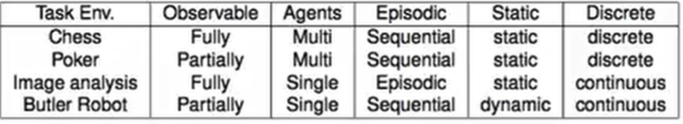
Example 2: Task Environments types of four agents: Chess, Poker, Image Analysis and Butler Robot

Slide 23
Environment Types
Below are lists of properties of a number of familiar environments
Problems | Observable | Deterministic | Episodic | Static | Discrete
Crossword Puzzle | Yes | Yes | No | Yes | Yes
Part-picking/cutting robot | No | No | Yes | No | No
Web shopping program | No | No | No | No | Yes
Tutor | No | No | No | Yes | Yes
Medical Diagnosis | No | No | No | No | No
Taxi driving | No | No | No | No | No
Hardest case: a environment that is inaccessible, sequential, non-deterministic, dynamic, continuous.

Slide 24
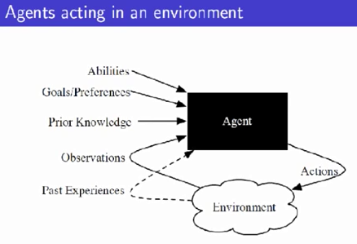

Slide 25
Hierarchy of Agent Types
Let’s have a closer look on the following five agent categories:-
Simple Reflex Agents
Model-Based Reflex Agents
Goal-Based Agents
Utility-Based Agents
Learning Agents

Slide 26
Simple Reflex Agents
Select action on the basis of current percept, ignoring all past percepts
It uses just condition-action rules
  The rules are like the form “if … then …”
  Efficient but have narrow range of applicability
  Because knowledge sometimes cannot be stated explicitly
  Work only
    If the environment is fully observable
  If car-in-front-is breaking then initiate-braking.
  Blinking when something approaches the eye.

Slide 27
Figure: Structure of a simple reflex agent
Simple Reflex Agent
sensors
What the world is like now
Environment
Condition - action rules
What action I should do now
effectors
function SIMPLE-REFLEX-AGENT(percept) returns action
static: rules, a set of condition-action rules
state ← INTERPRET-INPUT (percept)
rule ← RULE-MATCH (state,rules)
action ← RULE-ACTION [rule]
return action

Slide 28

A Simple Reflex Agent in Nature
Percepts
(size, motion)
RULES
(1) If small moving object, then activate SNAP
If large moving object,
then activate AVOID and inhibit SNAP
ELSE (not moving) then NOOP
Needed for completeness
Action: SNAP or AVOID or NOOP

Slide 29
Model-Based Reflex Agents
Maintains internal state that keeps track of aspects of the environment that cannot be currently observed
For the world that is partially observable
  If the car is a recent model - there is a centrally mounted brake light. With older models, there is no centrally mounted, so what if the agent gets confused?
  Is it a parking light? Is it a brake light? Is it a turn signal light?
  The agent has to keep track of an internal state
    That depends on the percept history
    Reflecting some of the unobserved aspects
    Example, driving a car and changing lane
Requiring two types of knowledge
  How the world evolves independently of the agent
  How the agent’s actions affect the world
  The agent is with memory

Slide 30
Figure: Structure of Model-Based reflex agent
State
sensors
How the world evolves
What the world is like now
What my actions do
Environment
Condition - action rules
What action I should do now
effectors
function REFLEX-AGENT-WITH-STATE (percept) returns action
static: state, a description of the current world state
rules, a set of condition-action rules
state ← UPDATE-STATE (state, percept)
rule ← RULE-MATCH (state, rules)
action ← RULE-ACTION [rule]
state ← UPDATE-STATE (state, action)
return action

Slide 31
Example Table Agent With Internal State
IF
THEN
Saw an object ahead, and turned right, and it’s now clear ahead | Go straight
Saw an object Ahead, turned right, and object ahead again | Halt
See no objects ahead | Go straight
See an object ahead | Turn randomly

Slide 32
Case Example for A Reflex Agent With Internal State
  The Wall-Following
start
The Actions are:-
  Left
  Right
  Straight
  Open-Door

Slide 33
The Rules are:-
If open(left) & open(right) and open(straight) then
  choose randomly between right and left
If wall(left) and open(right) and open(straight) then straight
If wall(right) and open(left) and open(straight) then straight
If wall(right) and open(left) and wall(straight) then left
If wall(left) and open(right) and wall(straight) then right
If wall(left) and door(right) and wall(straight) then open-door
If wall(right) and wall(left) and open(straight) then straight.
(Default) Move randomly

Slide 34
Goal-Based Agents
The agent uses goal information to select between possible actions in the current state
Current state of the environment is always not enough
The goal is another issue to achieve
  Judgment of rationality / correctness
Actions chosen ➔ goals, based on
  The current state
  The current percept
E.g. At a road junction, the taxi can turn left, right or go straight.

Slide 35
Conclusion
  Goal-based agents are less efficient
  But more flexible
    Agent ⬅ Different goals ⬅ different tasks
  Search and planning
    Two other sub-fields in AI
    To find out the action sequences to achieve its goal

Slide 36
Figure: Structure of a Goal-based agent
State
sensors
How the world evolves
What the world is like now
What my actions do
What it will be like if I do action A
Environment
Goals
What action I should do now
effectors
function GOAL_BASED_AGENT (percept) returns action
state ← UPDATE-STATE (state, percept)
action ← SELECT-ACTION [state, goal]
state ← UPDATE-STATE (state, action)
return action

Slide 37
Utility-Based Agents
The agent uses a utility function to evaluate the desirability of states that could result from each possible action
Goals alone are not enough
  To generate high-quality behavior
  Example, meals in Canteen, good or not ?
Many action sequences ➔ the goals
  Some are better and some worse
  If goal means success,
  Then utility means the degree of success (how successful it is).
E.g. route recommendation system
  There are many action sequences that will get the taxi to its destination, thereby achieving the goal.
  Some are quicker, safer, more reliable, or cheaper than others. We need to consider Speed and safety

Slide 38
Figure: Structure of a utility-based agent
State
sensors
How the world evolves
What the world is like now
What my actions do
What it will be like if I do action A
Environment
Utility
How happy I will be in such as a state
What action I should do now
effectors
function UTILITY_BASED_AGENT (percept) returns action
state ← UPDATE-STATE (state, percept)
action ← SELECT-OPTIMAL_ACTION [state, goal]
state ← UPDATE-STATE (state, action)
return action

Slide 39
It is said state A has higher utility
  If state A is more preferred than others
Utility is therefore a function
  That maps a state onto a real number
  The degree of success

Slide 40
Utility has several advantages:
  When there are conflicting goals,
    Only some of the goals but not all can be achieved
    utility describes the appropriate trade-off
  When there are several goals
    None of them are achieved certainly
    Utility provides a way for the decision-making

Slide 41
Learning Agents
To build learning machines and then to teach them.
After an agent is programmed, can it work immediately?
  No, it still need teaching
In AI,
  Once an agent is done
  We teach it by giving it a set of examples
  Test it by using another set of examples
We then say the agent learns
  A learning agent
learning agents are able to perform tasks , analyze performance and look for new ways to improve on those tasks

Slide 42
Four conceptual components
  Learning Element
    Which is responsible for making improvement
  Performance Element
    Which is responsible for selecting external actions
  Critic
    The learning element uses feedback from the critic on how the agent is doing and determines how the performance element should be modified to do better in the future.
    Tells the Learning element how well the agent is doing with respect to fixed performance standard.
      Feedback from user or examples, good or not?
Problem Generator
Responsible for suggesting actions that will lead to new and informative experiences

Slide 43
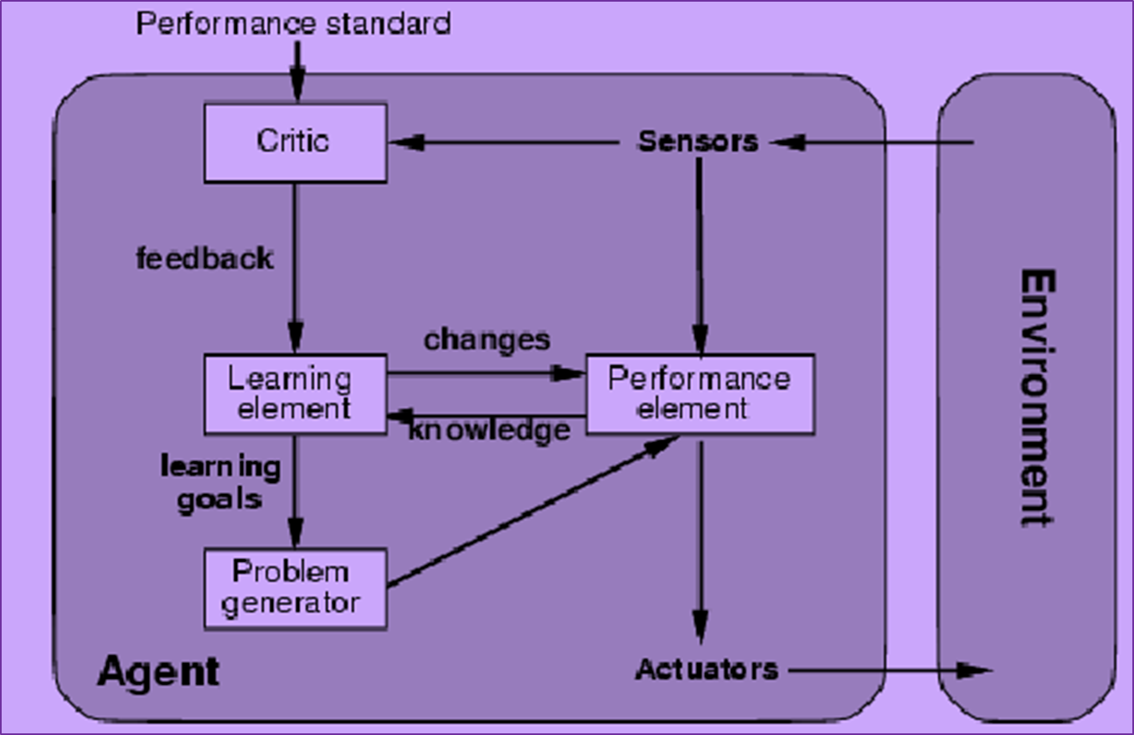
Figure: Structure of a Learning agent

Slide 44
Summery hierarchy in types of agents
Reflex agents:
These agents function in a current state, ignoring past history.
Responses are based on the event-condition-action rule (ECA rule) where a user initiates an event and the agent refers to a list of pre-set rules and pre-programmed outcomes.
Model-based agents:
These agents choose an action in the same way as a reflex agent, but they have a more comprehensive view of the environment.
A model of the world is programmed into the internal system that incorporates the agent's history.
Goal-based agents:
These agents expand upon the information model-based agents store by also including goal information, or information about desirable situations.

Slide 45
Utility-based agents:
These agents are similar to goal-based agents but provide an extra utility measurement which rates each possible scenario on its desired result and chooses the action that maximizes the outcome.
Rating criteria examples could be the probability of success or the resources required.
Learning agents:
These agents have the ability to gradually improve and become more knowledgeable about an environment over time through an additional learning element.
The learning element will use feedback to determine how performance elements should be changed to improve gradually.

